Slide 1
Machine Learning
AIML CZG565
Ensemble Learning
Neha Vinayak
BITS – CSIS - WILP

Slide 2

Machine Learning
Disclaimer and Acknowledgement
These content of modules & context under topics are planned by the course owner Dr. Sugata, with grateful acknowledgement to many others who made their course materials freely available online
We here by acknowledge all the contributors for their material and inputs.
We have provided source information wherever necessary
Students are requested to refer to the textbook w.r.t detailed content of the presentation deck shared over canvas
We have reduced the slides from canvas and modified the content flow to suit the requirements of the course and for ease of class presentation
Slide Source / Preparation / Review:
From BITS Pilani WILP: Profs.Sugata, Chetana, Monali, Rajavadhana, Seetha, Anita
External: CS109 and CS229 Stanford lecture notes, Dr.Andrew NG and many others who made their course materials freely available online

Slide 3
Course Plan
M1 | Introduction & Mathematical Preliminaries
M2 | Machine Learning Workflow
M3 | Linear Models for Regression
M4 | Linear Models for Classification
M5 | Decision Tree
M6 | Instance Based Learning
M7 | Support Vector Machine
M8 | Bayesian Learning
M9 | Ensemble Learning
M10 | Unsupervised Learning
M11 | Machine Learning Model Evaluation/Comparison

Slide 4


Ensemble Learning

Slide 5

The Single Model Philosophy
Motivation: Occam’s Razor
  “one should not increase, beyond what is necessary, the number of entities required to explain anything”
Infinitely many models can explain any given dataset
  Might as well pick the smallest one…

Slide 6
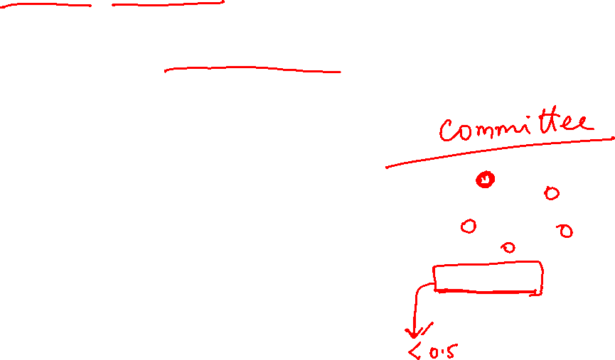
Ensemble Philosophy
No Free Lunch Theorem: There is no algorithm that is always the most accurate
Each learning algorithm dictates a certain model that comes with a set of assumptions
  Each algorithm converges to a different solution and fails under different circumstances
    The best tuned learners could miss some examples and there could be other learners which works better on (may be only) those !
  In the absence of a single expert ( a superior model ) , a committee (combinations of models) can do better !
    A committee can work in many ways ...
Weak learner does only slightly better than random guessing

Slide 7
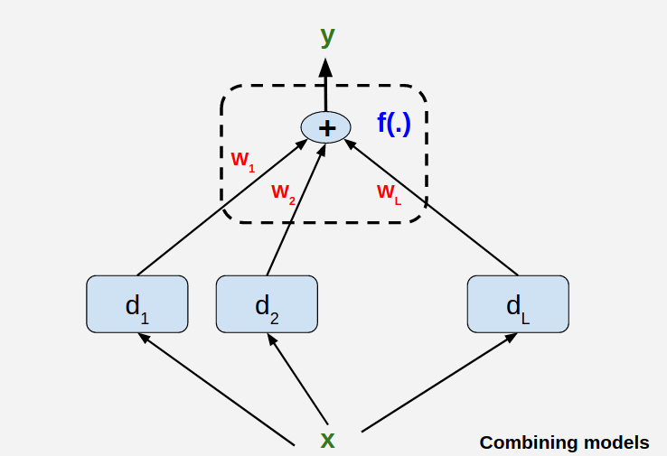
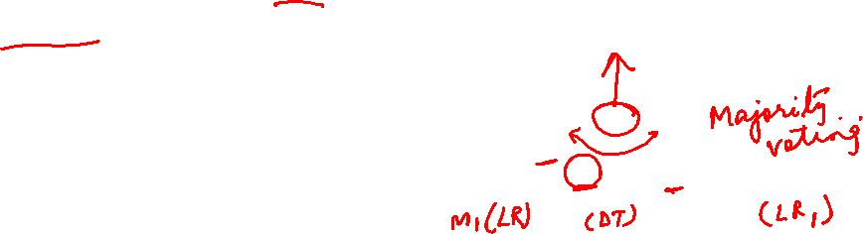
Committee of Models
Committee Members are base learners !
Major challenges dealing with this committee
  Expertise of each of the members (Does it help / not?)
  Combining the results from the members for better performance

Slide 8
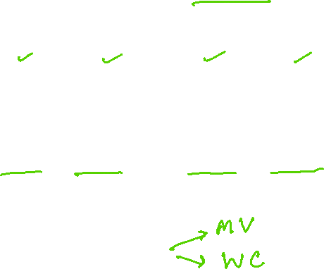
General Approach

Slide 9
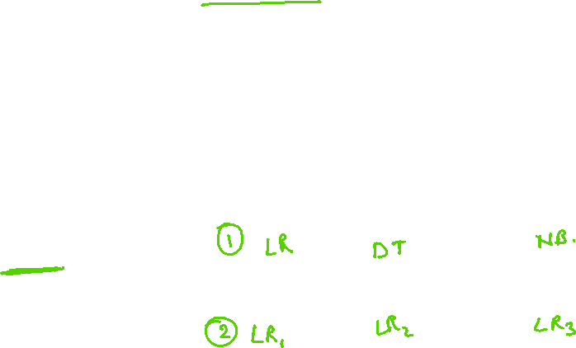
Issue 1 : On the members ( Base Learners )
It does not help if all learners are good/bad at roughly same thing
  Need Diverse Learners

Slide 10
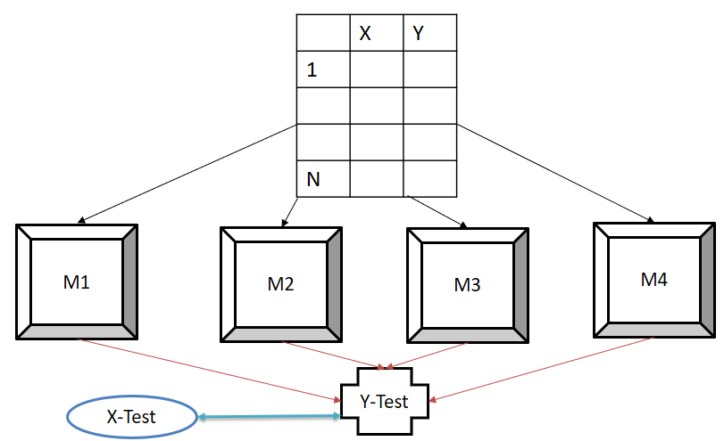
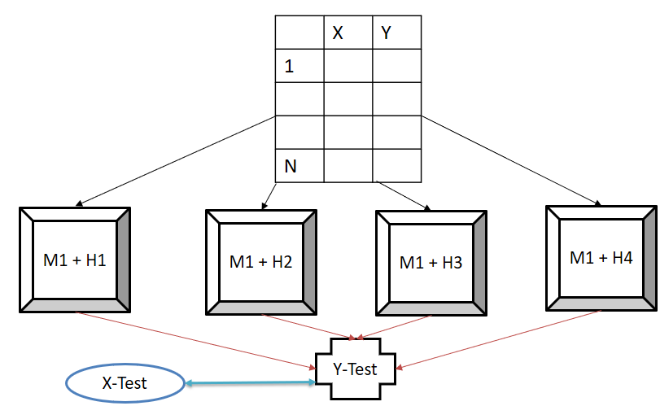
Issue 1 : On the members ( Base Learners )
Use Different Algorithms
  Different algorithms make different assumptions
Use Different Hyper parameters,
  E.g. vary the structure of neural nets

Slide 11
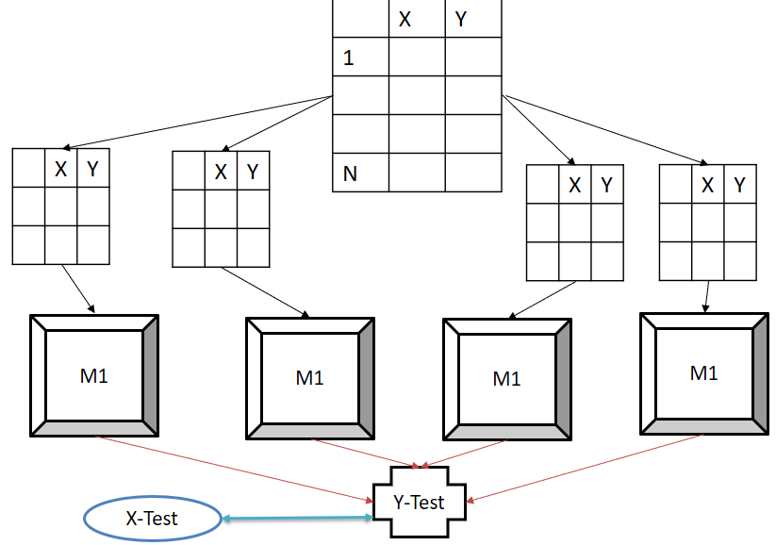
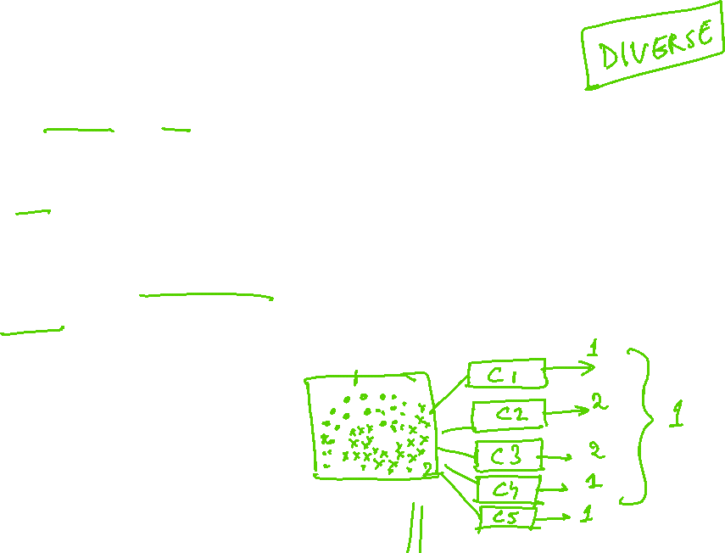
Issue 1 : On the members ( Base Learners )
Different input representations
  Uttered words + video information of speakers clips
  image + text annotations
Different training sets
  Draw different random samples of data
  Partition data in the input space and have learners specialized in those spaces (mixture of experts)

Slide 12
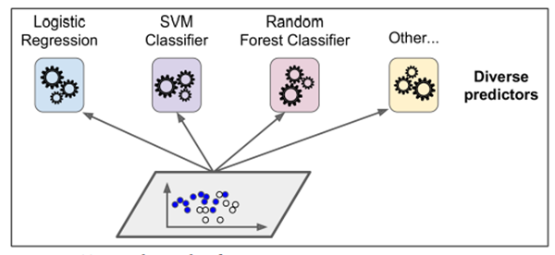

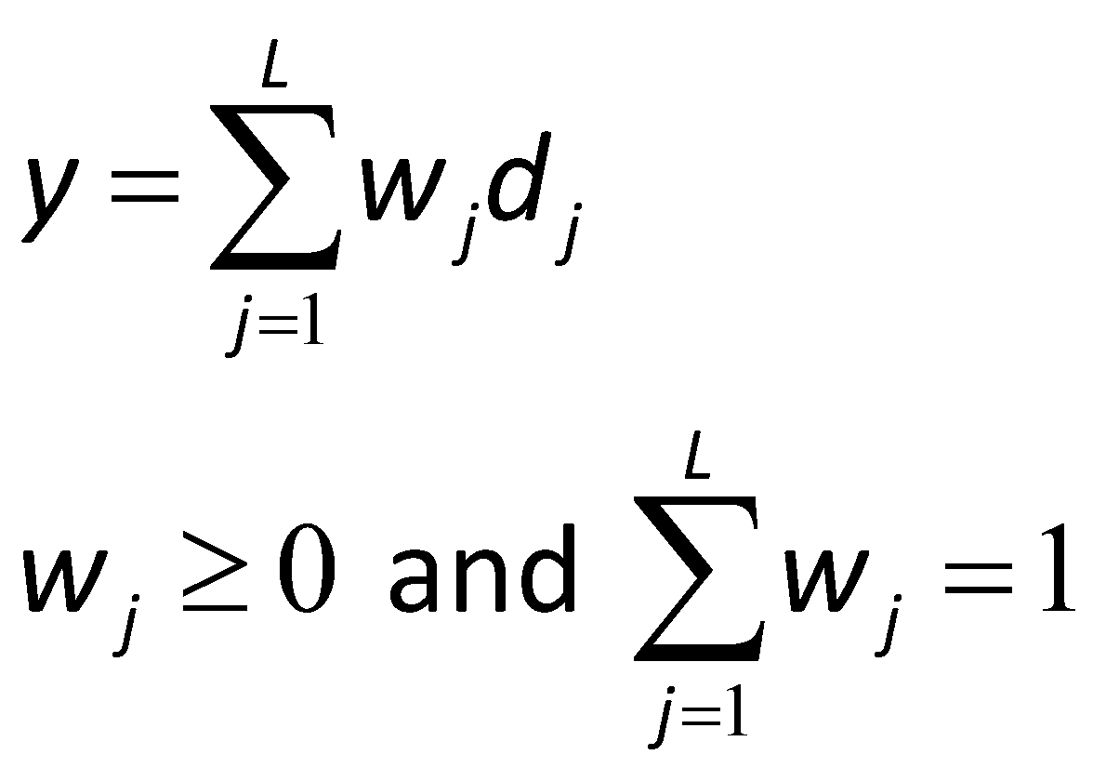
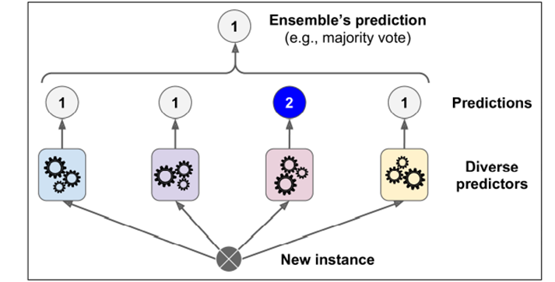
Issue -2 : Combining Results Base Learners
A Simple Combination Scheme:

Slide 13
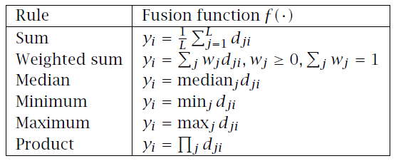

Issue -2 : Combining Results Base Learners

Slide 14
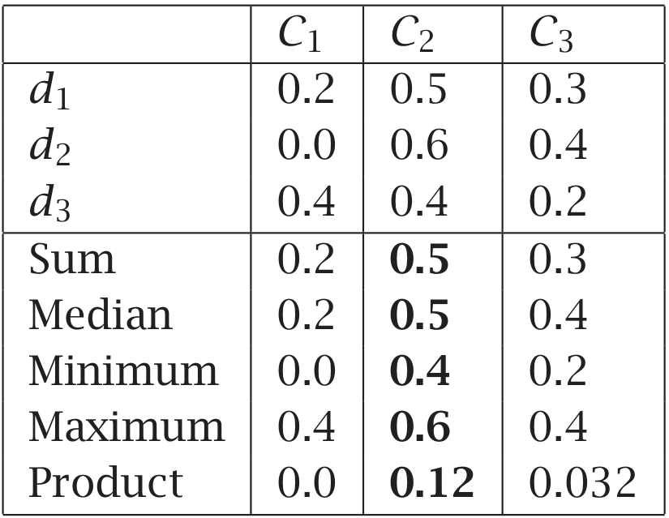

Issue -2 : Combining Results Base Learners
Avg

Slide 15
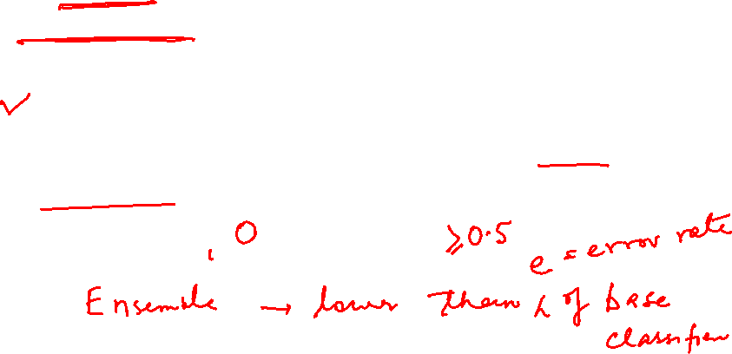
When Ensemble Methods Work?
Ensemble classifier performs better than the base classifiers when e is smaller than 0.5
Necessary conditions for an ensemble classifier to perform better than a single classifier:
  Base classifiers should be independent of each other
  Base classifiers should do better than a classifier that performs random guessing

Slide 16
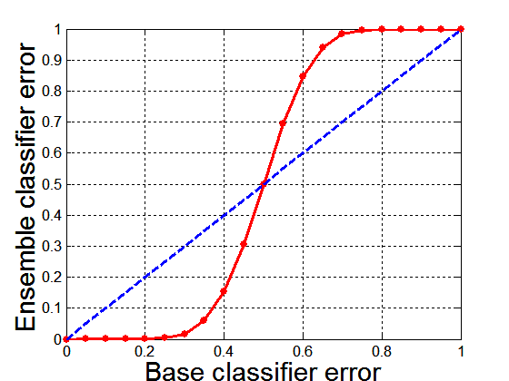
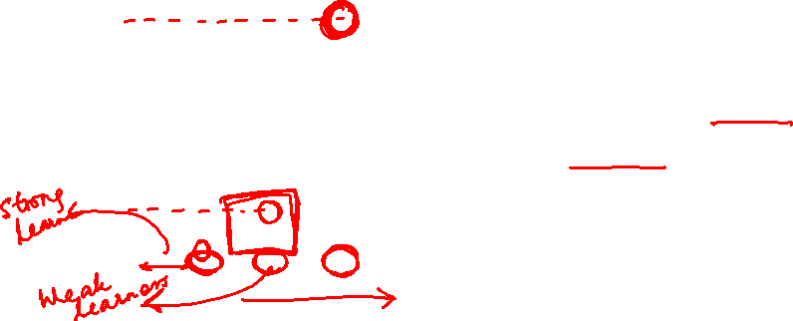
Necessary Conditions for Ensemble Methods
Ensemble Methods work better than a single base classifier if:
  All base classifiers are independent of each other
  All base classifiers perform better than random guessing (error rate < 0.5 for binary classification)
Classification error for an ensemble of 25 base classifiers, assuming their errors are uncorrelated.

Slide 17

Types of Ensemble Methods
By manipulating training set
  Example: bagging, boosting, random forests
By manipulating input features
  Example: random forests
Introduction to Data Mining, 2nd Edition

Slide 18

Bagging
Bootstrap Aggregating

Slide 19









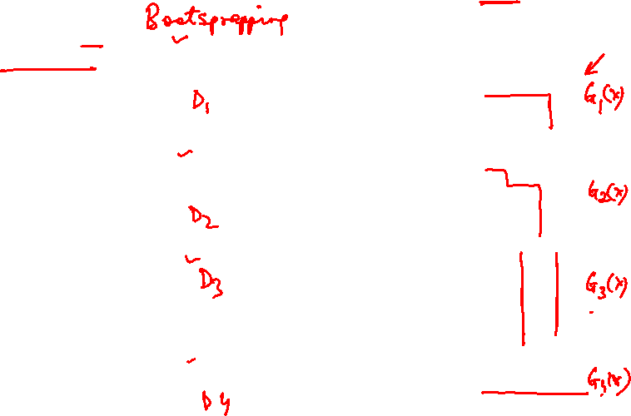
Bagging at training time
For m=1:M, Obtain bootstrap sample D_{m} from the training data D
Build a model G_{m}(x) from bootstrap data D_{m}
M subsets (with replacement)
Size(M) ≤ N
Training set
A base model (weak model) is created on each of these subsets

Slide 20









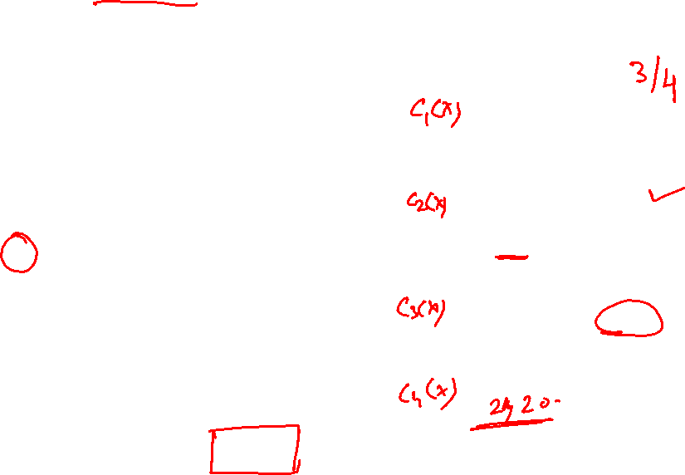
Bagging at inference time
The models run in parallel and are independent of each other
A test sample
Combine the predictions from all the models.
75% confidence

Slide 21
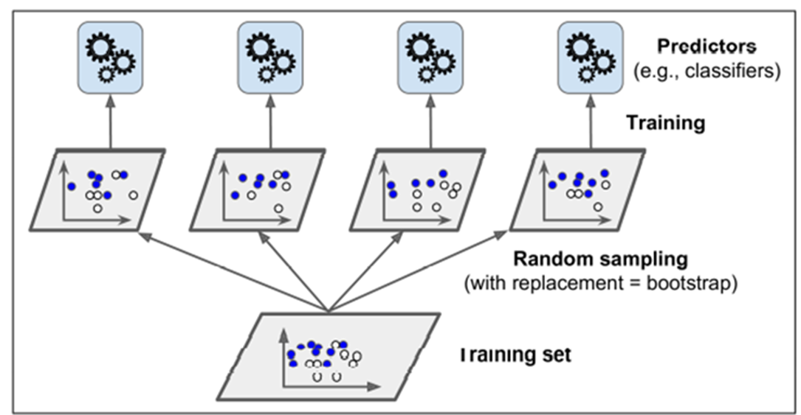

The Bagging Model
Regression
Classification:
  Vote over classifier outputs

Slide 22
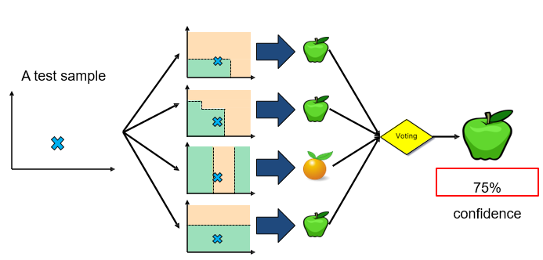
Bagging Algorithm

Slide 23
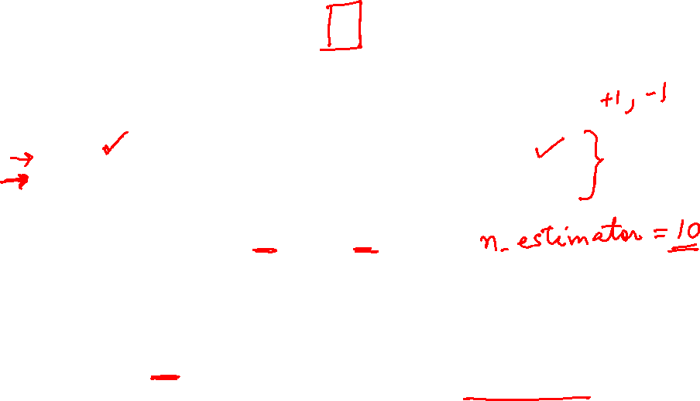
Bagging Example
Consider 1-dimensional data set:
Classifier is a decision stump
  Decision rule: x ≤ k versus x > k
  x < 0.35 or X >= 0.75.
  Split point k is chosen based on entropy
x ≤ k
Decision tree with one internal node (the root) which is immediately connected to the terminal nodes (its leaves). Decision stump makes a prediction based on the value of just a single input feature. Sometimes they are also called 1-rules
True
False
y_{left}
y_{right}

Slide 24
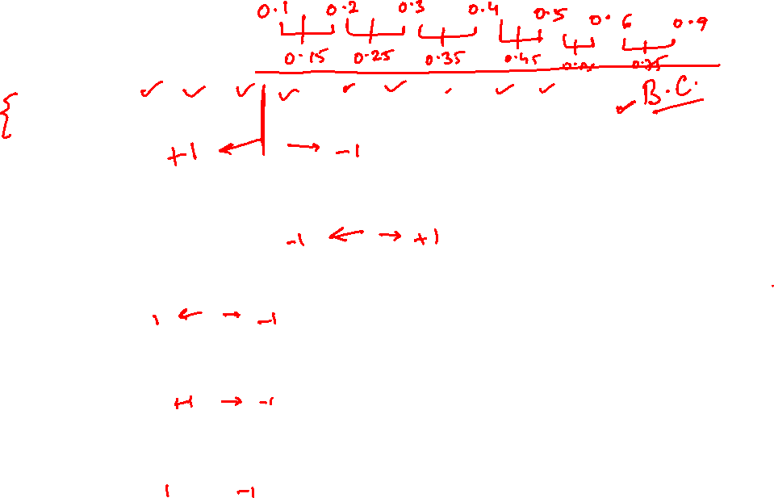
Bagging Example
X < = 0.7 → y= 1
X > 0.7 → y= 1
Introduction to Data Mining, 2nd Edition

Slide 25
Bagging Example
Introduction to Data Mining, 2nd Edition

Slide 26

Bagging Example
Summary of Training sets:
Introduction to Data Mining, 2nd Edition

Slide 27
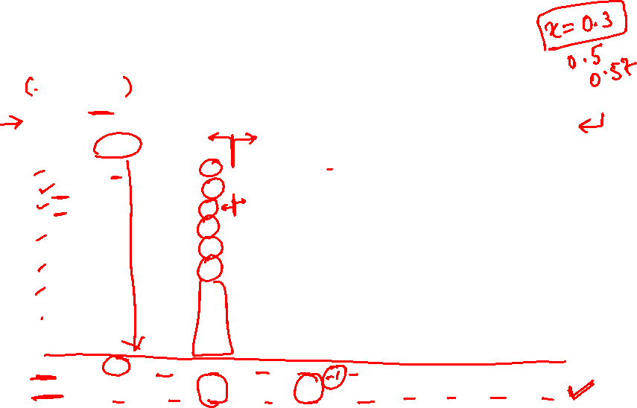
Bagging Example
Assume test set is the same as the original data
Use majority vote to determine class of ensemble classifier
Predicted Class
Introduction to Data Mining, 2nd Edition

Slide 28
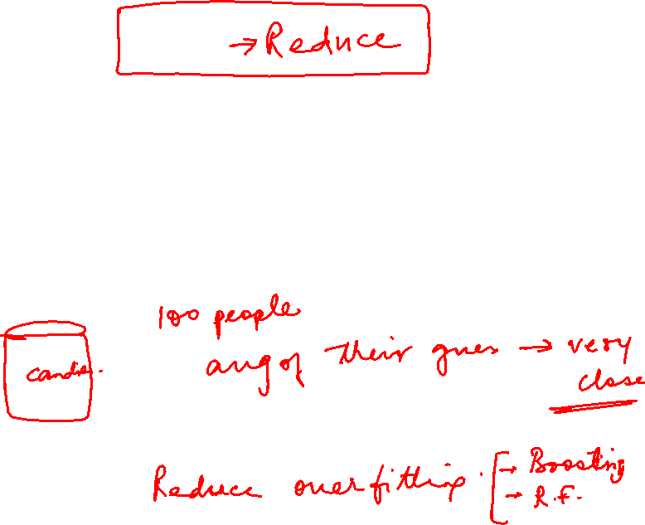
Bagging – Effect on Variance
Bagging helps make models like decision trees less jumpy or unstable.
It builds many models using different random samples of the data.
By combining their predictions, the final result becomes more consistent.
This makes the model less likely to overfit and work better on new data.

Slide 29
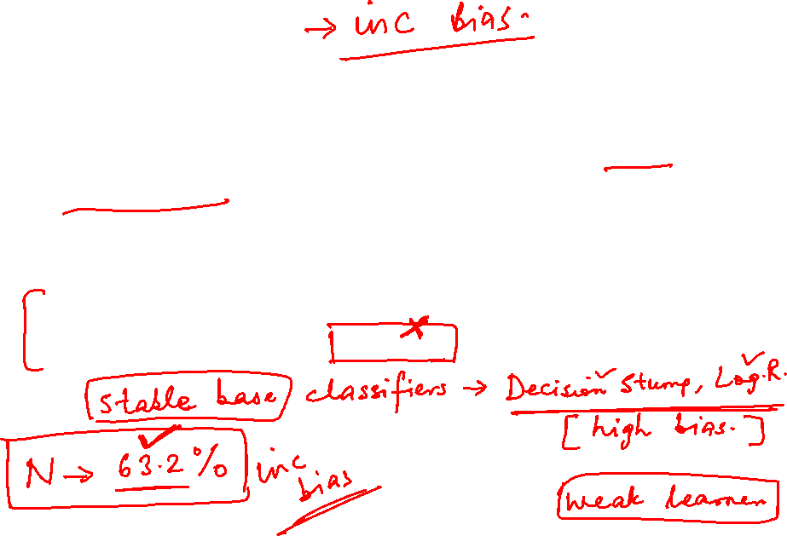
Bagging – Effect on Bias
If a base classifier is stable, i.e., robust to minor perturbations in the training set, then the error of the ensemble is primarily caused by bias in the base classifier.
In this situation, bagging may not be able to improve the performance of the base classifiers significantly.
It may even degrade the classifier's performance because the effective size of each training set is about 37% smaller than the original data.

Slide 30
References
Introduction to Data Mining, by Pang-Ning Tan, Michael Steinbach , Vipin Kumar
Bishop - Pattern Recognition And Machine Learning - Springer 2006
https://en.wikipedia.org/wiki/Gradient_boosting#:~:text=Gradient%20boosting%20is%20a%20machine,which%20are%20typically%20decision%20trees
https://medium.com/nerd-for-tech/gradient-boost-for-regression-explained-6561eec192cb
Unsupervised Learning
Next Session Plan

